Slide 1


Formal Analysis of Hybrid Systems
Prof. Pallab Dasgupta
Dept. of Computer Science & Engineering
Indian Institute of Technology, Kharagpur

Slide 2
A Model for Hybrid System
A hybrid system H = (Loc, Var, Lab, Edg, Act, Inv) Consists of six components:
A finite set Loc of vertices called locations.
A finite set Var of real valued variables.
We write V for the set of valuations. A valuation ν is a function that assigns a real-value ν(x) ∈ R to each variable x ∈ Var.
A state is a pair (ℓ, ν) consisting of a location ℓ ∈ Loc and a valuation ν ∈ V.
A finite set Lab of synchronization labels.
Lab necessarily contains the stutter label τ, i.e. τ ∈Lab.

Slide 3
A Model for Hybrid System
A finite set Edg of edges called transitions.
Each transition e = (ℓ, a,μ, ℓ’) consists of :
A source location ℓ ∈ Loc,
A target location ℓ’ ∈ Loc,
A synchronization label a ∈ Lab
A transition relation μ ⊆ V²
For each location ℓ ∈ Loc there is a set Con ⊆ Var of controlled variables and a stutter transition of the form (ℓ, τ, ID_{con} , ℓ), where (ν, ν ’) ∈ Id_{con} iff for all variables x ∈ Var, either x ∉ Con or ν(x) = ν ’(x).
The transition e is enabled in a state (ℓ, ν ) if for some valuation ν ’ ∈ V, (ν ,ν ’) ∈ μ. The state (ℓ’, ν ’) is then said to be a transition successor of (ℓ, ν ).

Slide 4
A Model for Hybrid System
A labeling function Act that assigns to each location ℓ ∈ Loc a set of activities.
Each activity is a function from the nonnegative reals R^{≥0} to V.
The activities of each location are time-invariant.
A labeling function Inv that assigns to each location ℓ ∈ Loc an invariant Inv(ℓ) ⊆ V.
The system may stay at a location only if the location invariant is true; that is, some discrete transition must be taken before the invariant becomes false.
The hybrid system H is time-deterministic if for every location ℓ ∈ Loc and every valuation ν ∈ V, there is at most one activity f ∈ Act(ℓ) with f(0) = ν. The activity f, then, is denoted by ϕ_{ℓ} [ν].

Slide 5
The runs of a hybrid system
The state of a hybrid system can change in two ways:
By a discrete and instantaneous transition that changes both the control location and the values of the variables according the transition relation;
By a time delay that changes only the values of the variables according to the activities of the current location.

Slide 6
The runs of a hybrid system
A run of the hybrid system H, then, is a finite or infinite sequence
of states σ_{i} = (ℓ_{i} , ν_{i} ) ∈ Σ nonnegative reals t_{i} ∈ R^{≥0} and activities f ∈ Act(ℓ_{i}), such that for all i ≥ 0:
f_{i} (0) = ν_{i}
For all 0 ≤ t ≤ t_{i} , f_{i} (t) ∈ Inv(ℓ_{i})
The state σ_{i+1} is a transition successor of the state
The state σ′_{i} is called a time successor of the state σ_{I} ;
The state σ_{i+1} is called a successor of σ_{i} .
We write [H] for the set of runs of the hybrid system H.

Slide 7
Hybrid systems as transition systems
With the hybrid system H, we associate the labeled transition system τ_{H} = (Σ, Lab" ∪ R^{≥0} ,→ ), when the step relation → is the union of the following two:
The transition-step relations →ª , for a ∈ Lab,
The time-step relations →^{t} , for t ∈ R^{≥0}

Slide 8
Hybrid systems as transition systems
The stutter transitions ensure that the transition system τ_{H} is reflexive. For all states σ , σ′ , ∈, Σ, Where σ = (ℓ, v) and for all t ∈ R^{≥0} ,
It follows that for every hybrid systems, the set of runs is closed under prefixes, suffixes, stuttering, and fusion [HNSY94].
For time-deterministic hybrid systems, Time can progress by the amount t ∈ R^{≥0} from the state (ℓ, v) if this is permitted by the invariant of location ℓ; that is :
We can rewrite the time-step rule for time-deterministic systems as :

Slide 9
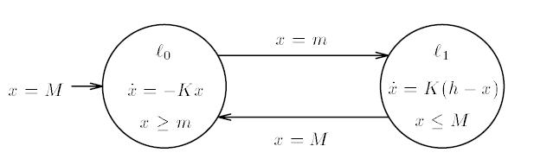
Example: Thermostat
When the heater is off, the temperature:
When the heater is on:
The resulting time-deterministic hybrid system is shown below:

Slide 10
The Parallel composition of hybrid systems
Let H₁=(Loc₁ Var, Lab₁, Edg₁, Act₁, Inv₁) and H₂=(Loc₂ Var, Lab₂, Edg₂, Act₂, Inv₂) be two hybrid systems over a common set Var of variables.
Let it be so that whenever H₁ performs a discrete transition with the synchronization label a ∈ Lab₁ ∩ Lab₂ , then so does H₂ .
The product H₁ x H₂ is the hybrid system (Loc₁ x Loc₁ , Var, Lab₁ U Lab₂, Edg, Act, Inv) such that:
((ℓ₁ ,ℓ₂), a, μ, (ℓ₁’ ,ℓ₂ ’ ) ∈ Edg iff
(ℓ₁, a₁, μ₁, ℓ₁’) ∈ Edg₁ and (ℓ₂, a₂, μ₂, ℓ₂’) ∈ Edg₂
Either a₁= a₂ = a; or a₁∉ Lab₂ and a₂ = τ ; or a₁ = τ and a₂ ∉ Lab_{1,}
μ = μ₁ ∩ μ₂;
Act(ℓ₁ ,ℓ₂) = Act₁(ℓ₁) ∩ Act₂(ℓ₂)
Inv(ℓ₁ ,ℓ₂) = Inv₁(ℓ₁) ∩ Inv₂(ℓ₂)

Slide 11
The Parallel composition of hybrid systems
It follows that all runs of the product system are runs of both component systems:
The product of two time-deterministic hybrid systems is also time-deterministic.

Slide 12
Linear Hybrid Systems
A linear term over the set Var of variables is linear combination of the variables in Var with integer coefficients.
A linear formula over Var is a boolean combination of inequalities between linear terms over Var.
The time-deterministic hybrid system H = (Loc Var, Lab, Edg, Act, Inv) is linear if its activities, invariants, and transition relations can be defined by linear expressions over the set Var of variables:
For all locations ℓ ∈ Loc , the activities Act(ℓ) are defined by a set of differential equations of the form , one for each variable x ∈ Var , where k_{x} ∈ Ζ is an integer constant: for all valuation v ∈ V, variables x ∈ Var , and nonnegative reals t ∈ R^{≥0} .

Slide 13
Linear Hybrid Systems
For all location ℓ ∈ Loc the invariant Inv(ℓ) is defined by a linear formula ψ over Var.
For all transitions e ∈ Edg the transition relation μ is defined by a guarded set of nondeterministic assignments.
Here, the guard ψ is a linear formula, and both interval boundaries α_{x} and β_{x} are linear terms for each variable x ∈ Var :

Slide 14
Special cases of linear hybrid systems
If Act(ℓ.x) = 0 for each location ℓ ∈ Loc then x is a discrete variable. A discrete system is a linear hybrid system all of whose variables are discrete.
A discrete variable x is a proposition if μ(e, x) ∈ {0, 1} for each transition e ∈ Edg. A finite-state system is a linear hybrid system all of whose variables are proposition.
If Act(ℓ.x) = 1 for each location ℓ and μ(e, x) ∈ {0, x} for each transition e, then x is a clock. Thus:
The value of a clock increases uniformly with time, and
A discrete transition either resets a clock to 0, or leaves it unchanged.
A timed automation is a linear hybrid system all of whose variables are propositions or clocks, and the linear expressions are boolean combinations of inequalities of a particular form.

Slide 15
Special cases of linear hybrid systems
If there is a nonzero integer constant k ∈ Ζ such that Act(ℓ, x) = k for each location ℓ and μ(e, x) ∈ {0, x} for each transition e, then x is a skewed clock. A multirate timed system is a linear hybrid system all of whose variables are propositions and skewed clocks. An n-rate timed system is a multirate timed system whose skewed clocks proceed at n different rates.
If Act(ℓ, x) ∈ {0, 1} for each location ℓ and μ(e, x) ∈ {0, x} for each transition e, then x is an integrator. It is basically a clock that is typically used to measure accumulated durations. An integrator system is linear hybrid system all of whose variables are propositions and integrators.

Slide 16
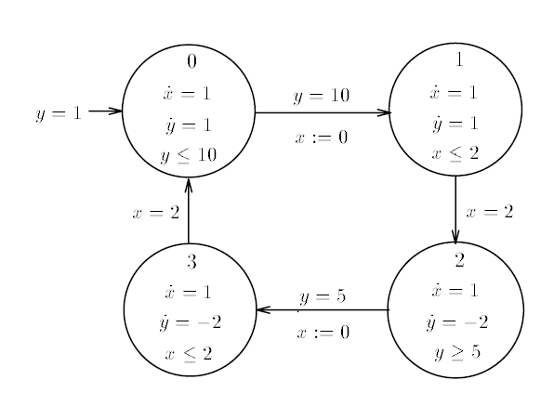
Examples of Linear Hybrid Systems
A Water-level monitor:

Slide 17
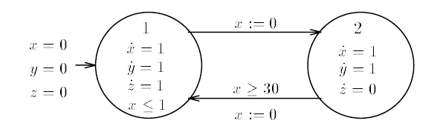
Examples of Linear Hybrid Systems
A leaking gas burner:

Slide 18
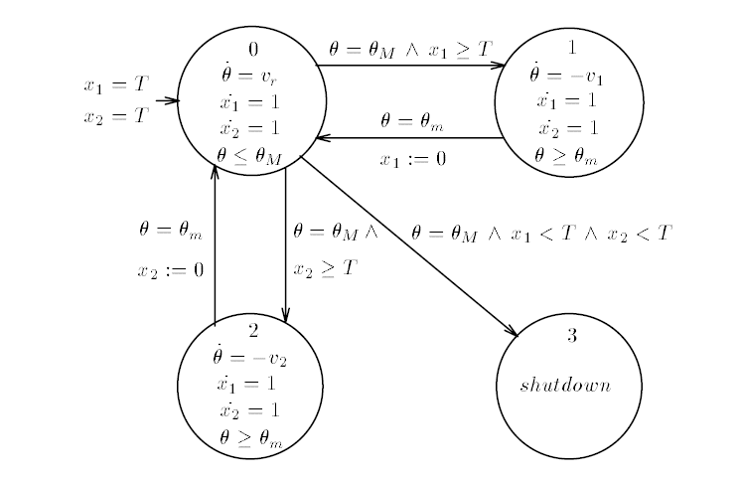
Examples of Linear Hybrid Systems
A temperature control system:

Slide 19
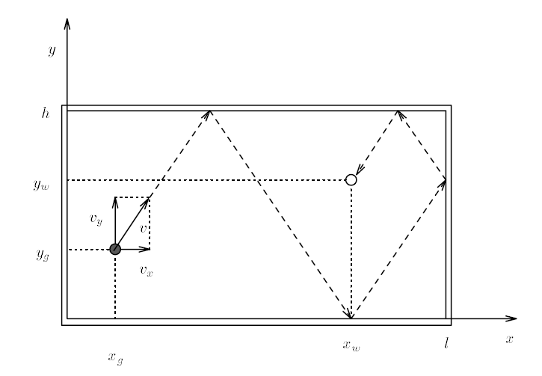
Examples of Linear Hybrid Systems
A game of billiards:

Slide 20
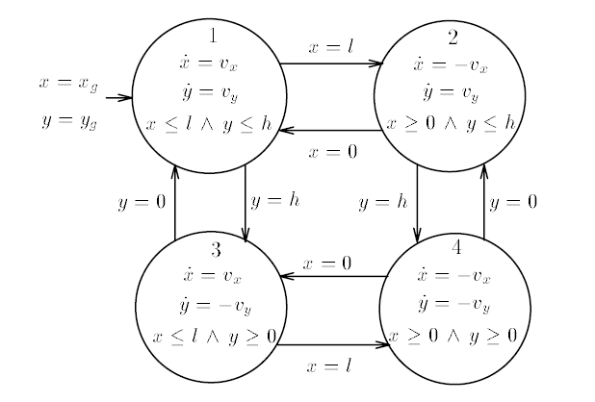
Examples of Linear Hybrid Systems
Game of billiards, movement of the grey ball:

Slide 21
The Reachability Problem for Linear Hybrid Systems
Let σ and σ′ are two states of a hybrid system H.
The state σ′ is reachable from the state σ , written σ →* σ′ if there is a run of H that starts in σ and ends in σ′ .
The reachability question asks, then, if σ →* σ′ f or two given states σ and σ′ of a hybrid system H.
The verification of invariance properties is equivalent to the reachability question: a set R ⊆ Σ of states is an invariant of the hybrid system H iff no state in Σ - R is reachable from an initial state of H.

Slide 22
A decidability result
A linear hybrid system is simple if all linear atoms in location invariabts and transition guards are of the form x ≤ k or k ≤ x, for a variable x ∈Var and an integer constant k∈Ζ.
For multirate timed systems the simplicity condition prohibits the comparison of skewed clocks with different rates.
Theorem 3.1: The reachability problem is decidable for simple multirate timed systems.

Slide 23
Two Undecidability results
Theorem 3.2: The reachability problem is undecidable for 2-rate timed systems.
Theorem 3.3: The reachability problem is undecidable for simple integrator systems.

Slide 24
The verification of Linear Hybrid Systems
Forward Analysis: Preliminary Definitions
Given a location ℓ ∈ Loc and a set of valuations P ⊆ V, the forward time closure of P at ℓ is the set of valuations that are reachable from some valuation v ∈ P.
Thus for all valuation v′ ∈ , There exist a valuation v ∈ P and a nonnegative real t ∈R^{≥0} such that (ℓ, v) →^{ℓ} (ℓ, v′ )
Given transition e = (ℓ, a, μ, ℓ′ ) and a set of valuation P ⊆ V, the post condition post_{e}[P] of P with respect to e is the set of valuations that are reachable from some valuation v ∈ P by executing the transition e;
Thus for all valuations v′ ∈ post_{e}[P], there exists a valuation v ∈ P such that (ℓ, v) →ª (ℓ′, v′)




Slide 25
The verif. of Lin. Hyb. Sys.: Forward Analysis
A set of states is called a region.
Given a set P ⊆ V of valuations, by (ℓ, P) we denote the region {(ℓ, v) | v ∈ P}.
We write (ℓ, v) ∈ (ℓ, P) iff v∈ P.
For a region ,



Slide 26
The verif. of Lin. Hyb. Sys.: Forward Analysis
A symbolic run of the linear hybrid system H is a finite or infinite sequence
: (ℓ₀, P₀) (ℓ₁, P₁) … (ℓ_{i}, P_{i}) …
of regions such that for all i ≥ 0, there exists of transitions e_{i} from ℓ_{i} to ℓ_{i +1} and
The symbolic run a represents the set of all runs of the form
such that (ℓ_{i}, v_{i}) ∈ (ℓ_{i}, P_{i}) for all i ≥ 0.


Slide 27
The verif. of Lin. Hyb. Sys.: Forward Analysis
Given a region I ⊆ ∑ the reachable region of I is the set of all states that are reachable from states in I:
Proposition 4.1: Let be a region of the linear hybrid system H. The reachable region
is the least fixpoint of the equation.
or equivalently, for all locations ℓ ∈ Loc , the set R_{ℓ} of valuations is the least fixpoint of the set of equations:
.



Slide 28
The verif. of Lin. Hyb. Sys.: Forward Analysis
Lemma 4.1: For all linear hybrid systems H, if P ⊆ V is a linear set of valuations, then for all locations ℓ ∈ Loc and transitions e ∈ Edg, both and post_{e}[P] are linear sets of valuations.
By Lemma 4.1, if R is a linear region, then so are both and post_{e}[R]



Slide 29
Example, Forward Analysis: The leaking gas burner
Recap:
. . . Contd.

Slide 30
Example, Forward Analysis: The leaking gas burner
Let I be the set of initial states defined by the linear formula
The set of reachable states is characterized by the least fixpoint of the two equations
which can be iteratively computed as





Slide 31
Backward Analysis
↙
Given a location ℓ ∈ Loc and a set of valuation P⊆ V the backward time closure ⟨P⟩_{ℓ} of P at ℓ is the set of valuations from which it is possible to reach some valuation v ∈ P by letting time progress:
Thus for all valuations v′ ∈ ⟨P⟩_{ℓ} , there exist a valuation v ∈ P and a nonnegative real t ∈ R^{≥0} such that (ℓ,v′) →^{t} (ℓ′,v′) .
Given a transition e =(ℓ, a, μ, ℓ′) and a set of valuation P⊆ V, the precondition pre_{e}[P] of P with respect to e is the set of valuation from which it is possible to reach a valuation v ∈ P by executing the transition e:
↙
↙

Slide 32
Thus, for all valuation v′∈Pre_{e}[P], there exists a valuation v ∈ P such that (ℓ,v′) →ª (ℓ′,v)
The backward time closure and the precondition can be naturally extended to regions: for R = ⋃_{ℓ∈Loc} (ℓ, R_{ℓ}),
Given a region R ⊆ Σ , the initial region (↦* R) ⊆ Σ of R is the set of all states from which a state in R is reachable:
Notice that R ⊆ (↦* R).
↙
↙

Slide 33
Proposition 4.2 Let R = ⋃_{ℓ∈Loc} (ℓ, R_{ℓ}) be a region of the linear hybrid system H. The initial region I = ⋃_{ℓ∈Loc} (ℓ, I_{ℓ}) is the list fixpoint of the equation.
Or equivalently, for all locations ℓ∈Loc , the set I_{ℓ} of valuations is the least fixpoint of the set.
Lemma 4.2 For all linear hybrid systems H, if P ⊆ V is a linear set of valuations, then for all locations ℓ∈Loc and transitions e∈Edg, both ⟨P⟩_{ℓ} and pre_{e}[P] are linear sets of valuations.
↙
↙
↙

Slide 34
Example: Backward analysis
The region R defined by the linear formula
Should be not reachable from the set I of initial states defined by the linear formula
The set (↦* R) of states from which it is possible to reach a state in R is characterized by the least fixpoint of the two equations.
Which can be iteratively computed as:
↙
↙
↙
↙

Slide 35
The verif. of Lin. Hyb. Sys.: Approximate Analysis
We compute upper approximations of the sets
of states which are reachable from the initial states I (forward analysis)
of states from which the region R is reachable (backward analysis)
For forward analysis, the set X_{ℓ} of reachable states at location ℓ is given by proposition 4.1 as:
Two problems arise in the practical resolution of such a system:
Handling disjunctions of systems of linear inequalities; for instance there is no easy way for deciding if a union of polyhedra is included into another.
The fixpoint computation may involve infinite iteration.



Slide 36
The verif. of Lin. Hyb. Sys.: Approximate Analysis
An approximate solution to these problems is provided by abstract interpretation techniques.
Union of polyhedra is approximated by their convex hull. Let denote the convex hull operator:
The system of equations becomes:
To enforce the convergence of iterations, we apply Cousot's “widening technique”.
Π
Π

Π

Slide 37
The verif. of Lin. Hyb. Sys.: Approximate Analysis
The idea is to extrapolate the limit of a sequence of polyhedra in such a way that an upper approximation of the limit be always reached in a finite number of iterations.
We define a widening operator, noted ∇, on polyhedra, such that:
For each pair (P, P′) of polyhedra, P P′ ⊆ P ∇ P′
For each infinite increasing sequence (P₀, P₁,….. P_{n},….) of polyhedra, the sequence defined by Q₀ = P₀, Q_{n+1} = Q_{n} ∇ P_{n+1} is not strictly increasing (i.e., remains constant after a finite number of terms).
Π

Slide 38
The verif. of Lin. Hyb. Sys.: Approximate Analysis
The widening operator is used as follows:
Choose, in each loop of the graph of the hybrid system, at least one location, and call them “widening location” (So, removing these locations would cut each loop in the graph).
Let be the n-th step computation at location ℓ; that is,
Instead, for each widening location ℓ and each step n ≥ 1, compute

Π

Slide 39
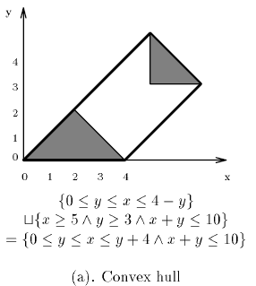
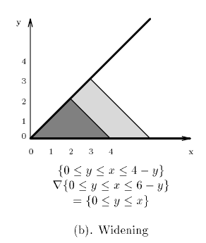
The verif. of Lin. Hyb. Sys.: Approximate Analysis
Approximation Operators:

Slide 40
Example, Approximate Analysis: The leaking gas burner
With I defined by ψ_{I} = (pc = 1 ∧ x = y = z = 0), we have with and (choosing location 1 as the only widening location):



Slide 41
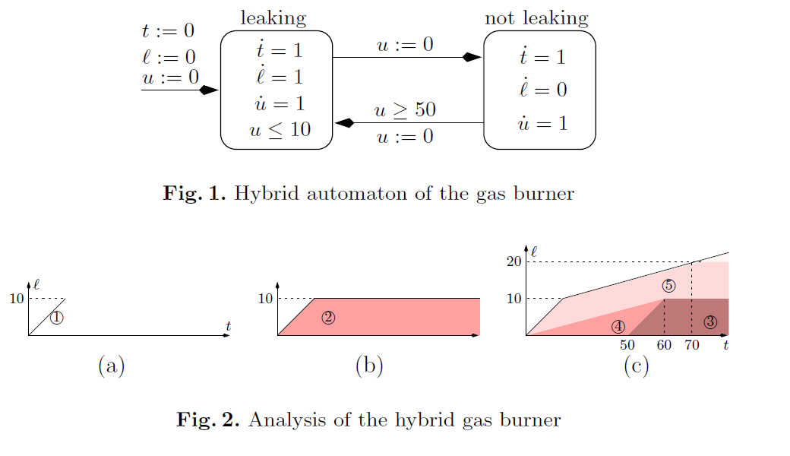
Analysis of Leaking Gas Burner
Step-1: Leaking location reached with {t=l=0}, and as time elapses we get the
polyhedron {0≤ t = l≤ 10} (Region (1) in Fig. 2.a)
Source: [Gonnord, Halbwachs, LNCS 4134] Combining widening and acceleration in linear relation analysis.

Slide 42
Analysis of Leaking Gas Burner
Step-2: Non-leaking location is reached with {0≤ t = l≤ 10}. As time elapses, we
get {0≤ l≤ 10, t ≥ l }. (Region (2) in Fig. 2.b)
Source: [Gonnord, Halbwachs, LNCS 4134] Combining widening and acceleration in linear relation analysis.

Slide 43
Analysis of Leaking Gas Burner
Step-3: We go back to leaking location with {0≤ l≤ 10, t ≥ l+50 }, (Region (3) in Fig. 2.c)
Convex hull with {t = l =0 } gives {0≤ l≤ 10, t ≥ 6l }, (Region (4) in Fig. 2.c)
Source: [Gonnord, Halbwachs, LNCS 4134] Combining widening and acceleration in linear relation analysis.

Slide 44
Analysis of Leaking Gas Burner
Step-3 (contd): Time passage yields {0≤ l≤ 20, t ≥ l, t ≥ 6l – 50 }. Now standard
widening yields {0≤ l≤ t, t ≥ 6l – 50 }. (Region (5) in Fig. 2.c)
Source: [Gonnord, Halbwachs, LNCS 4134] Combining widening and acceleration in linear relation analysis.

Slide 45
Minimization
We extend the next relation to regions:
We write for the reflexive transitive closure of
Let π be a partition of the state space Σ. A region R ∈ π is stable if for all R′ ∈ π
The partition π is a bisimulation if every region R ∈ π is stable.
Or Equivalently

∅


Slide 46
Minimization
The partition π respects the region R_{F} if for every region R ∈ π, R ⊆ R_{F} or R ∩ R_{F} = ∅
Our objective is to construct the coarsest bisimulation that respects a given region R_{F}, provided there is a finite bisimulation that respects R_{F}.
The function split[π](R) splits the region R ∈π into subsets that are “more” stable with respect to π:


Slide 47
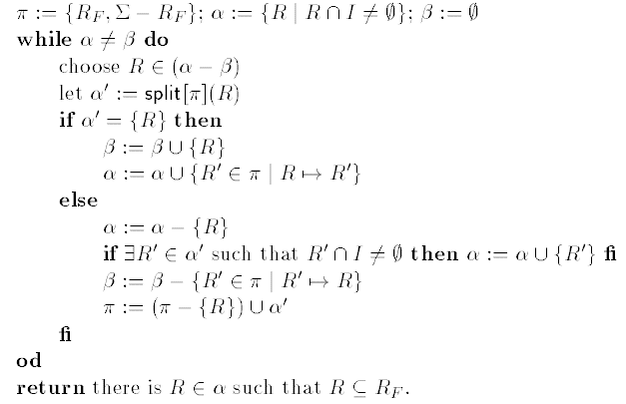
Minimization
The minimization procedure returns YES iff I R_{F}.
State-space minimization:

Slide 48
Model Checking
Timed computation tree logic:
Let C be a set of clocks not in Var; that is C ∩ Var = ∅ .
A state predicate is a linear formula over the set Var ∪ C of variables.
The formulas of TCTL, then, are defined by the following grammar, where ψ is a state predicate and z ∈ C.
The formal Φ is closed if all occurrences of a clock z ∈ C are within the scope of a reset quantifier z.
Φ ::= ψ | ¬ Φ | Φ₁ ∨ Φ₂ | z. Φ | Φ₁ ∃u Φ₂ | Φ₁ ∀u Φ₂

Slide 49
Timed Computation Tree Logic
The closed formulas of TCTL are interpreted over the state space Σ of a linear hybrid system H.
A state σ satisfies the TCTL-formula Φ₁ ∃u Φ₂ if there exists a run of H from σ to a state σ’ satisfying Φ₂ such that Φ₁ ∨ Φ₂ continuously holds along the run.
A state σ satisfies the TCTL-formula Φ₁ ∀u Φ₂ if every divergent run of H from σ leads to a state σ’ satisfying Φ₂ such that Φ₁ ∨ Φ₂ continuously holds from σ to σ’ .
Clocks can be used to express timing constraints.
E.g. z. (true ∃u (Φ Λ z ≤ 5)) asserts that there is a run on which Φ is satisfied within 5 time units.

Slide 50
Timed Computation Tree Logic
Standard abbreviations:
∀ ◊ Φ ≡ true ∀u Φ
∃ ◊ Φ ≡ true ∃u Φ
∃ Φ ≡ ¬ ∀ ◊ ¬ Φ
∀ Φ ≡ ¬ ∃ ◊ ¬ Φ
∃ ◊ _{<5} Φ ≡ z. ∃ ◊ (Φ ∧ (z < 5))

Slide 51
Timed Computation Tree Logic
Let be a run of the linear hybrid system H, with σ_{i} =(ℓ_{i} ,ν_{i}) for all i ≥ 0:
A position π of ρ is a pair (i, t) consisting of a nonnegative integer i and a nonnegative real t ≤ t_{i} .
The position of ρ are ordered lexicographically; that is , (i, t) ≤ (j, t′) iff i < j, or i = j and t ≤ t′.
For all positions π =(i, t) of ρ,
The state ρ (π) at the position π of ρ is (ℓ_{i}, ϕ_{ℓ} [v_{i}](t)), and
The time δ_{ρ} (π) at the position π of ρ is t + Σ_{j<i} t_{j}
A clock valuation ξ is function from C to R^{≥0} .
By ξ + t we denote the clock valuation ξ′ such that ξ′(z) = ξ(z) + t for all clocks z ∈ C.
By ξ [z := 0] we denote the valuation ξ′ such that ξ′(z) = 0 and ξ′(z′ ) = ξ(z′) for all clocks z′ ≠ z.
An extended state (σ, ξ) consists of a state σ∈Σ and a clock valuation ξ.

Slide 52
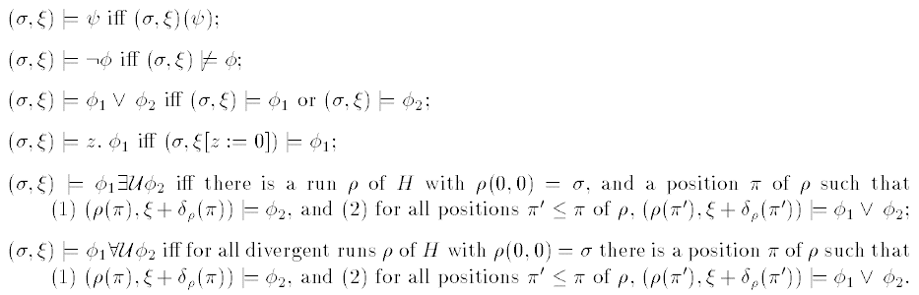
Timed Computation Tree Logic
The extended state(σ, ξ) satisfies the TCTL-formula Φ ,denoted (σ, ξ) ⊨ Φ if:
Let Φ be a closed formula of TCTL. We write σ ⊨ Φ if (σ, ξ) ⊨ Φ for all clock
valuations ξ.
The Linear hybrid system H satisfies Φ , denoted H ⊨ Φ , if all states of H satisfy Φ .

Slide 53
The model-checking algorithm
The Characteristic set ⟦ Φ ⟧ ⊆ Σ of Φ is the set of states that satisfy Φ .
Given a closed TCTL-formula Φ , a model-checking algorithm computes the characteristic set ⟦ Φ ⟧
Definition of binary next or single step until operator ▷:
Given two regions R, R′ ⊆ Σ, the region R ▷ R′ is the set of states σ that have a successor σ′ ∈ R′ such that all states between σ and σ′ are contained in R ∪ R′ :
I.e., (ℓ ,ν) ∈(R ▷ R′) iff:
I.e., the operator ▷ is a “single-step until” operator.
For a linear formula ψ , we extend the tcp operator such that
⟦ψ⟧

Slide 54
The model-checking algorithm
For a state σ = (ℓ, v) ∈ Σ we write ϕ[σ] for the function ϕ_{ℓ}[v], and for a region R =⋃_{ℓ∈Loc}∈Σ (ℓ,R_{ℓ}) we write.
Now, for two regions R, R′ ⊆ Σ, we define the region R ▷R′ as
Lemma 4.3: For all linear hybrid systems H, if R and R′ are two linear regions of H, then so is R ▷ R′.

Slide 55
The model-checking algorithm
Let R and R′ be the characteristic sets of the two TCTL-formulas Φ and Φ′, respectively. The characteristic set of the formula Φ ∃u Φ ′ can be iteratively computed as ⋃_{i} R_{i} with
R₀ = R′, and
For all i ≥ 0, R_{i+1} = R_{i} ⋃ (R ▷ R_{i})
To check if the TCTL-formula Φ is an invariant of H, we check if the set of initial states is contained in the characteristic set of the formula ∀ Φ . This characteristic set can be iteratively computed as ⋂_{i} R_{i} with
R₀ = ⟦ Φ ⟧, and
for all i ≥ 0, R_{i+1} = R_{i} ⋃¬ (true ▷ ¬R_{i})
The real-time response property asserting that a given event occurs within a certain time bound is expressed in TCTL by a formula of the form ∀ ◊_{≤c} Φ, whose characteristic set can be iteratively computed as ¬ ⋃_{i} R_{i}[z : = 0] with
R₀ = ⟦z > c⟧, and
For all i ≥ 0, R_{i+1} = R_{i} ⋃((¬R) ▷ R_{i}),
where R = ⟦ Φ ⟧ and z ∈ C

Slide 56
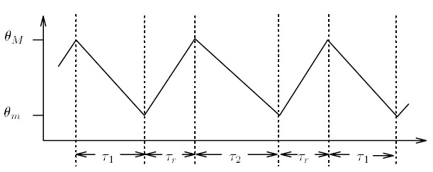
Example: the temperature control system
System requirement: Maintain the temperature of the coolant between Θ_{m} and Θ_{M}.
If temperature rises to Θ_{M} and cannot decrease because no rod is available, a complete shutdown is required.
Will the system ever reach the shutdown state?

Slide 57
Example: the temperature control system
TCTL formula stating that state 3 (shutdown) is always unreachable:
(pc = 0 Λ Θ ≤ Θ_{M} Λ x₁ ≥T Λ x₂ ≥T ) → ∀ ¬(pc = 3)

Slide 58
Thank you very much!!

